Slide 1

F.3 Summer Mathematics
Inequality

Slide 2












$$>$$
$$≥$$
$$x −3$$
$$x 8$$
e.g. $10, 13, 28…$
e.g. $−3, −2, −1…$
Greater than
Greater than or equal to
$$≤$$
$$>$$
$$x −3$$
$$x 8$$
e.g. 0, 5, 6$…$
e.g. $−3, −5, −10…$
Smaller than
Smaller than or equal to

Slide 3



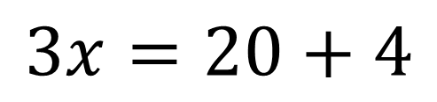



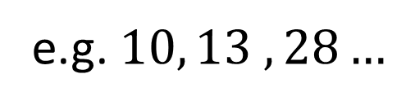


$$3x−4=20$$
$$3x−4>20$$
$$3x=20+4$$
$$3x>20+4$$
$$3x=24$$
$$3x>24$$
$$x=8$$
$$x>8$$
e.g. $10, 13 ,28…$

Slide 4





























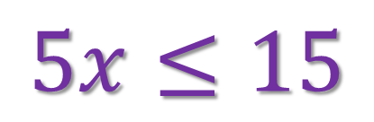




$$x$$
$$+3$$
$$<$$
$$5$$
$$+3$$
$$x$$
$$−2$$
$$10$$
$$−2$$
$$>$$
$$x$$
$$<$$
$$5$$
$$−3$$
$$x$$
$$>$$
$$10$$
$$+2$$
$$x<2$$
$$x>12$$
$$5x≤15$$
$$\frac{x}{4}≥2$$
$$5$$
$$4$$
$$\frac{15}{}$$
$$x$$
$$≤$$
$$x≥2$$
$$×4$$
$$5$$
$$x$$
$$≥$$
$$8$$
$$x≤3$$

Slide 5




















$$−\frac{x}{4}≥2$$
$$−\frac{x}{4}=2$$
$$4$$
$$4$$
$$−x≥2$$
$$×4$$
$$−x=2$$
$$×4$$
開口
尖頭
$$−x$$
$$=$$
$$−x$$
$$≥$$
$$8$$
$$8$$
$$x$$
$$=$$
$$−8$$
$$x$$
$$≤$$
$$−8$$
尖頭
開口

Slide 6


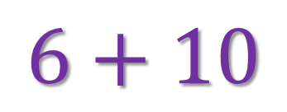
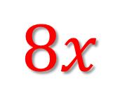


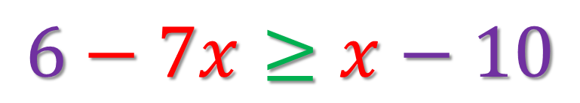

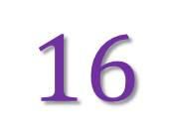


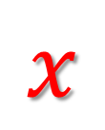

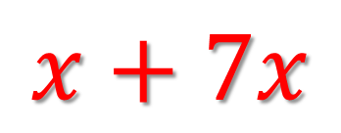
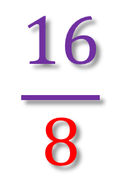

$$6−7x≥x−10$$
$$6+10$$
$$≥$$
$$x+7x$$
$$16$$
$$≥$$
$$8x$$
$$\frac{16}{8}$$
$$≥$$
$$x$$
$$2$$
$$≥$$
$$x$$
開口
尖頭
$$x$$
$$≤$$
$$2$$
尖頭
開口

Slide 7


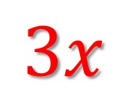
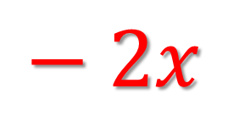
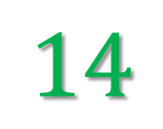
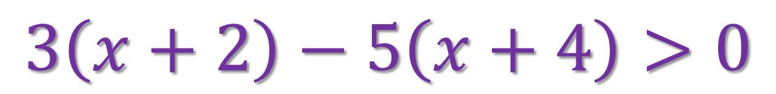

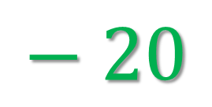



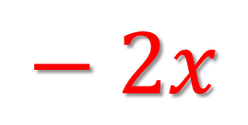
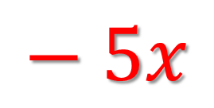

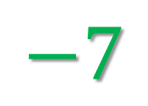
$$3\left(x+2\right)−5\left(x+4\right)>0$$
$$3x$$
$$+ 6$$
$$− 5x$$
$$− 20$$
$$>0$$
$$− 2x$$
$$−14$$
$$>0$$
$$− 2x$$
$$>$$
$$14$$
$$x$$
$$<$$
$$−7$$

Slide 8





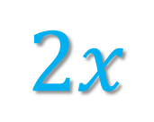













$$2x+1<\frac{4x+1}{3}$$
$$3$$
$$(2x+1)<4x+1$$
$$3$$
$$6x$$
$$+3$$
$$<$$
$$4x+1$$
$$4x$$
$$+ 1$$
$$6x−4x$$
$$<$$
$$+1−3$$
$$2x$$
$$<$$
$$−2$$
$$x$$
$$<$$
$$−1$$

Slide 9










































































$$<$$
$$>$$
$$−$$
$$+$$
$$>$$
$$+$$
$$+$$
$$−$$
$$<$$
$$−$$
x
$$\text{3}$$
$$\text{3}$$
$$\text{7}$$
$$\text{3}$$
x
$$\text{3}$$
$$\text{3}$$
$$\text{7}$$
$$\text{3}$$
$$+$$
$$>$$
$$\text{10}$$
$$+$$
$$<$$
$$\text{4}$$
x
$$\text{0}$$
x
$$\text{0}$$
$$\text{x}$$
$$<$$
$$\text{4}$$
$$\text{x}$$
$$>$$
$$\text{10}$$
$$\text{0}$$
$$\text{4}$$
$$\text{0}$$
$$\text{4}$$
$$>$$
$$+$$
$$−$$
$$≤$$
$$−$$
$$<$$
x
$$\text{6}$$
$$\text{6}$$
$$\text{10}$$
$$\text{6}$$
$$\text{7}$$
$$+$$
$$\text{15}$$
$$<$$
$$\text{x}$$
$$−$$
$$\text{15}$$
$$+$$
$$\text{15}$$
$$+$$
$$≤$$
$$\text{4}$$
$$<$$
x
$$\text{0}$$
$$\text{22}$$
$$\text{x}$$
$$\text{x}$$
$$≤$$
$$\text{4}$$
$$\text{x}$$
$$>$$
$$\text{22}$$
$$\text{0}$$
$$\text{22}$$
$$\text{0}$$
$$\text{4}$$

Slide 10






$\text{Q}11\text{.}$ $3x<15$
$$<$$
3x
15
$$<$$
3
3
$$\text{x} < \text{5}$$
$$\text{0}$$
$$\text{5}$$

Slide 11








$$\frac{3x}{7}<8$$
$$\text{Q}20\text{.}$$
$$<$$
3x
$$<$$
8
$$×$$
7
$$\text{0}$$
56
3x
$$<$$
56
3
56
x
$$<$$
3

Slide 12








$\text{Q}23\text{.}$ $−x+3>7$
$$<$$
$$− \text{x}+\text{3}−\text{3} > \text{7}−\text{3}$$
$$− \text{x}+\text{0} >\text{4}$$
$$\text{0}$$
$$\text{4}$$
$$− \text{x} >\text{4}$$
$$\text{x} < \text{4}$$

Slide 13








































$$\frac{x+1}{2}≥\frac{9x+5}{19}$$
$$\text{∗}\text{Q}1\text{.}$$
x$+$ 1
9x$+$ 5
($\text{2}$
$$×$$
$$\text{19}\text{)}$$
$$≥$$
($\text{2}$
$$×$$
$$\text{19}\text{)}$$
2
19
$$\text{1}\text{)}$$
$$\text{2}$$
($\text{9}\text{x}$
$$\text{5}\text{)}$$
$$\text{19}$$
$$+$$
$$+$$
($\text{x}$
$$≥$$
$$\text{1}\text{9}\text{x}$$
$$+$$
$$\text{19}$$
$$≥$$
$$\text{18}\text{x}$$
$$+$$
$$\text{1}\text{0}$$
$$\text{1}\text{9}\text{x}$$
$$−$$
$$\text{18}\text{x}$$
$$≥$$
$$\text{10}$$
$$−$$
$$\text{1}\text{9}$$
$$\text{x}$$
$$≥$$
$$−\text{9}$$

Slide 14






















$$x+16>\frac{2x}{13}+5$$
$$\text{∗}\text{Q}5\text{.}$$
2x
$$\text{x}$$
$$−$$
$$>$$
$$−$$
$$\text{1}\text{6}$$
$$\text{5}$$
13
13x
2x
$$−$$
$$>$$
$$−$$
$$\text{1}\text{6}$$
$$\text{5}$$
13
13
11x
$$>$$
$$−\text{11}$$
13
$$>$$
13
$$\text{x}$$
$$−\text{11}$$
$$×$$
11
$$\text{x}$$
$$>$$
$$−\text{13}$$

Slide 15
































$$\frac{5x}{3}−2<\frac{10x}{9}+3$$
$$\text{∗}\text{Q}6\text{.}$$
5x
10x
$$−$$
$$\text{2}$$
$$<$$
$$+$$
$$\text{3}$$
3
9
5x
10x
$$−$$
$$<$$
$$\text{3}$$
$$+$$
$$\text{2}$$
3
9
3
5x
10x
$$×$$
$$−$$
$$<$$
$$\text{3}$$
$$+$$
$$\text{2}$$
3
3
9
15x
10x
$$−$$
$$<$$
$$\text{3}$$
$$+$$
$$\text{2}$$
9
9
5x
$$<$$
$$\text{5}$$
9
9
$$\text{x}$$
$$<$$
$$\text{5}$$
$$×$$
5
$$\text{x}$$
$$<$$
$$\text{9}$$

Slide 16























$$1+\frac{x}{7}+\frac{x−3}{2}≥3 (x+1)$$
$$\text{∗}\text{Q}9\text{.}$$
$$\text{x}$$
$$\text{x}−\text{3}$$
$$\text{(}\text{7}×\text{2}\text{)}$$
$$+$$
$$\text{(}\text{7}×\text{2}\text{)}$$
$$+$$
$$\text{(}\text{7}×\text{2}\text{)}$$
$$≥$$
$$\text{3}\text{(}\text{x}+\text{1}\text{)}$$
$$\text{(}\text{7}×\text{2}\text{)}$$
$$\text{7}$$
2
$$\text{14}+\text{2}\text{x}+\text{7}\text{(}\text{x}−\text{3}\text{)}≥\text{4}\text{2}\text{(}\text{x}+\text{1}\text{)}$$
$$\text{14}+\text{2}\text{x}+\text{7}\text{x}−\text{21}≥\text{4}\text{2}\text{x}+\text{42}$$
$$\text{14}−\text{21}−\text{42}≥\text{4}\text{2}\text{x}−\text{2}\text{x}−\text{7}\text{x}$$
$$−\text{49}≥\text{33}\text{x}$$
$$−\text{49}$$
$$≥$$
$$\text{x}$$
33
$$−\text{49}$$
$$\text{x}$$
$$≤$$
33

Slide 17




















$\text{∗}\text{Q}13\text{.}$ $\frac{−3x+5}{2}≥\frac{11−x}{3}$
$$−\text{3}\text{x}+\text{5}$$
$$\text{11}−\text{x}$$
$$×$$
$$\text{(}\text{2}×\text{3}\text{)}$$
$$≥$$
$$×$$
$$\text{(}\text{2}×\text{3}\text{)}$$
2
3
$\text{(}−\text{3}\text{x}+\text{5}\text{)}×\text{3}≥\text{(}\text{11}−\text{x}\text{)}$ $×\text{2}$
$$−\text{9}\text{x}+\text{15}≥\text{22}−\text{2}\text{x}$$
$$−\text{9}\text{x}+\text{15}+\text{2}\text{x}−\text{15}≥$$
$$\text{22}−\text{2}\text{x}+\text{2}\text{x}−\text{15}$$
$$−\text{7}\text{x}≥\text{7}$$
$$\text{x}≤\text{1}$$

